Slide 1
Estimating Epidemic Severity Rates
Jeremy Goldwasser

Slide 2
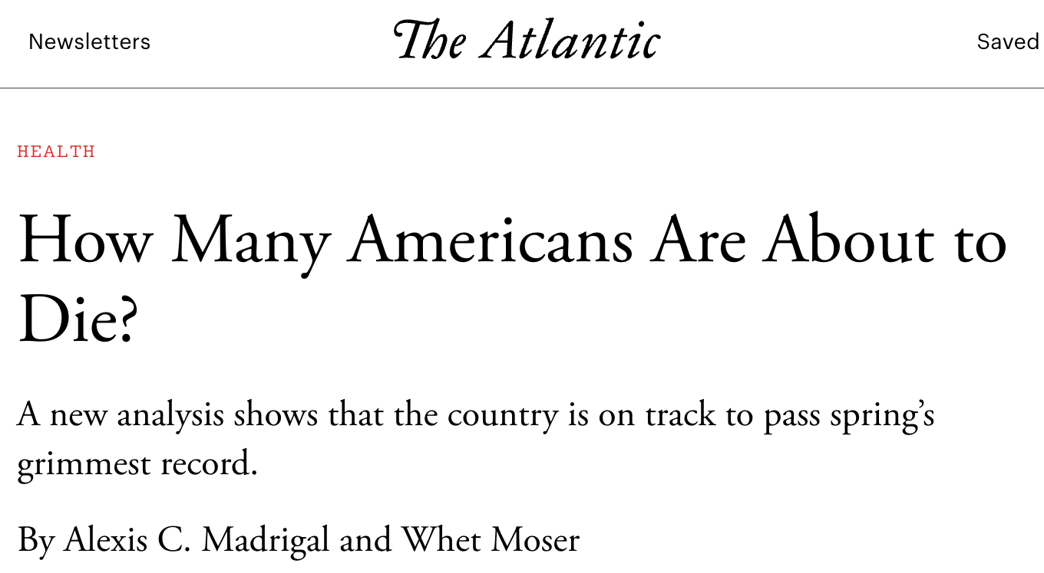
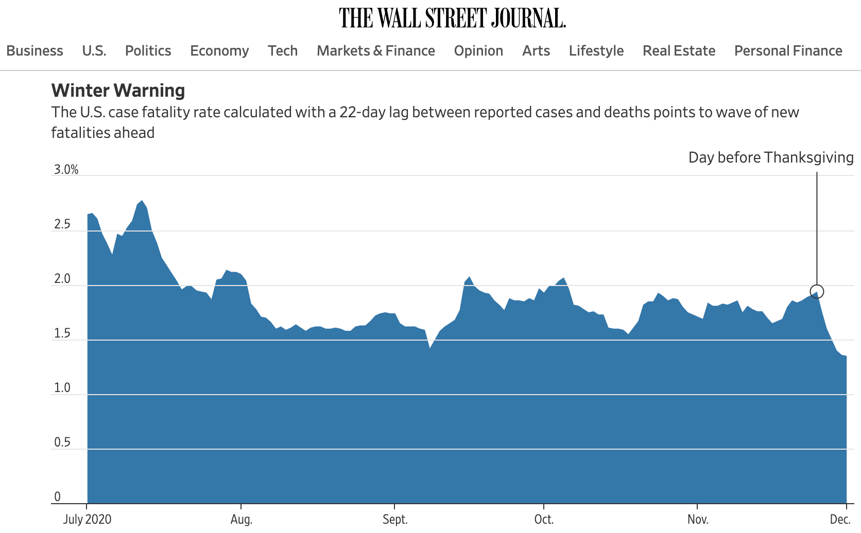
Time-varying severity rates in epidemiology
Severity rates express the probability that a primary event at time t will result in serious secondary event, e.g.
Case-fatality rate (CFR)
Hospitalization-fatality rate (HFR)
Time-varying or stationary?
Most academic work on estimating severity rates assumes stationarity over time.
Severity rates constantly change due to new variants, therapeutics, etc.
Epidemiologists at the CDC use time-varying rates to analyze new risks.
Notes:
150k forecasted cases/day, 1.5% CFR, >2k deaths/day

Slide 3
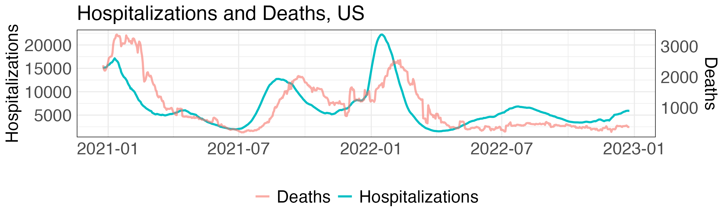
Often estimate severity from aggregate data
Calculating severity rates is straightforward with a line list of patient outcomes.
CFR: Observe fraction of patients that tested positive at t who ultimately die.
Maintaining such a line list may be unrealistic or impossible
In this case, severity rates must be estimated from aggregate count data.
Notes:
Give numbers for X counts, Y counts, completeness of linelist

Slide 4
Standard ratio estimators
Most estimators for severity rates are simple ratios (“case fatality ratio”) between secondary events and at-risk primary events
The standard time-varying approach is a lagged ratio of aggregate counts:
A more principled generalization uses the delay distribution:
Our work: Understanding the bias of these ratios and proposing statistically sound alternatives.
Notes:
Note estimate of the delay distribution can be used. Obtain from line list, or from aggregate. Typically fit parametric model, not so hard.

Slide 5
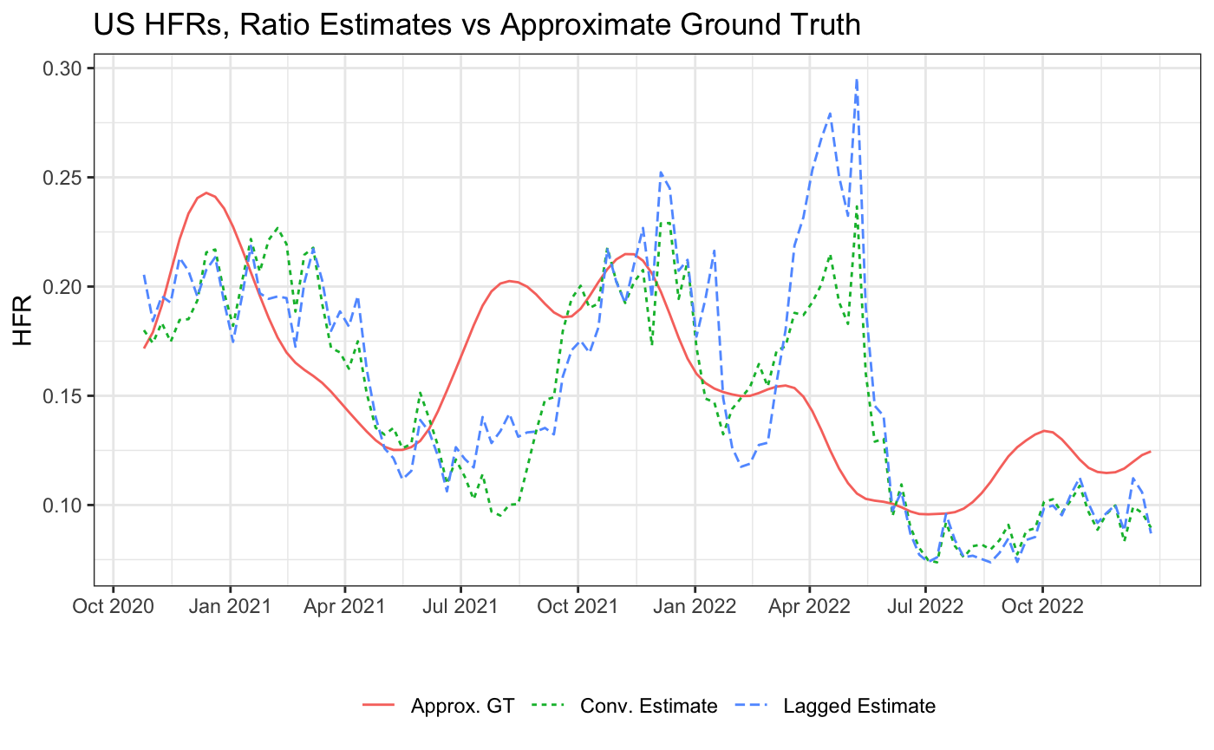
Observed these ratios exhibit huge bias
Notable failures, HFR:
Signaled enormous, nonexistent surge after Omicron peak – especially lagged ratio.
Ignored higher risk as Delta took over
Findings robust across parameters, geography, etc.
Notes:
Mention A) “ground truth” only a proxy, and B) lagged in new reports, twitter threads etc

Slide 6
Ingredients of Analysis: Data Streams
Let X_{t} denote the primary incidence time series
Let Y_{t} denote the secondary incidence time series.
We focus on HFR because there is decent ground truth data.
In theory, they have the following relation:
In practice, real-world data may be messier due to e.g. day-of-week effects or data dumps.
Notes:
Point-wise true

Slide 7

Ingredients of Analysis: Statistical Model
Given
Taking expectation reveals convolution of hospitalizations with delay distribution $π$ and HFRs p:

Slide 8
Recreate bias on simulated data
Noiseless simulation, so Y_{t} = E[ Y_{t}|X_{s≤t} ] from the previous slide
Even when hospitalizations are flat, the estimated HFR is up to 50% too high!

Slide 9
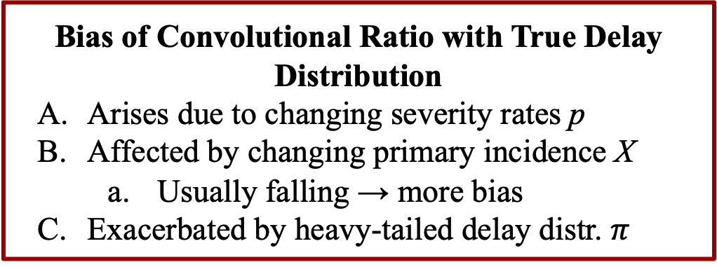
Well-specified analysis
Bias of Convolutional Ratio with True Delay Distribution
Arises due to changing severity rates p
Affected by changing primary incidence X
Usually falling → more bias
Exacerbated by heavy-tailed delay distr. $π$
For a stationary oracle delay distribution $π$,
B
C
A
A
B
C
Notes:
Elaborate on content of figures

Slide 10
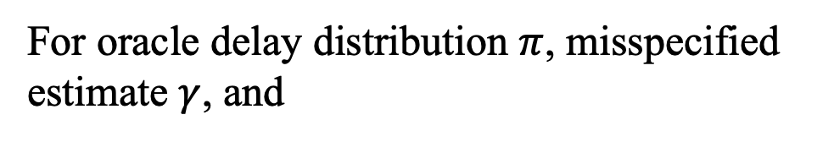
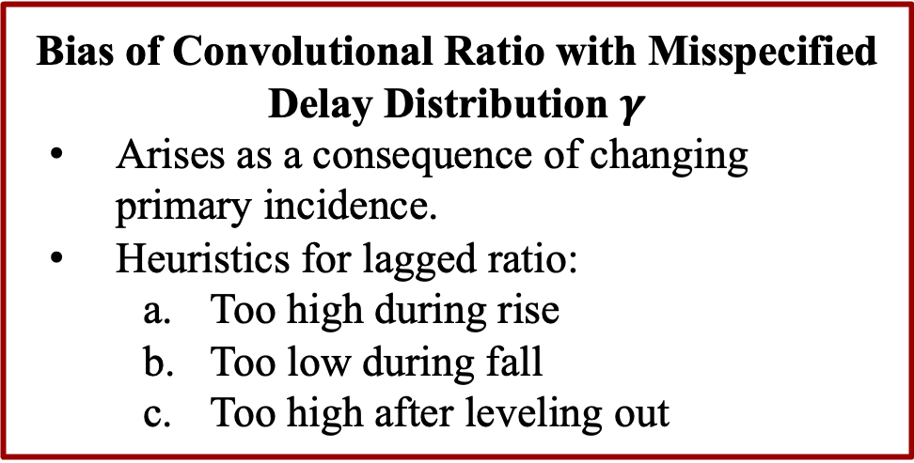
Misspecified analysis
For oracle delay distribution $π$, misspecified estimate $γ$, and
A
C
B
Bias of Convolutional Ratio with Misspecified Delay Distribution $γ$
Arises as a consequence of changing primary incidence.
Heuristics for lagged ratio:
Too high during rise
Too low during fall
Too high after leveling out
A
B
C
Notes:
point out on slide 9 that it’s actually possible for misspecification to reduce the bias

Slide 11
State-level results
We estimate HFRs on JHU, which uses deaths aligned by report date – not the date the actually occurred.
Longer reporting delays → heavier-tailed delay distribution → more bias (well-specified)
Convolutional ratio consistently outperforms lagged ratio, which again is
Too high during rise
Too low during fall
Too high after leveling out

Slide 12
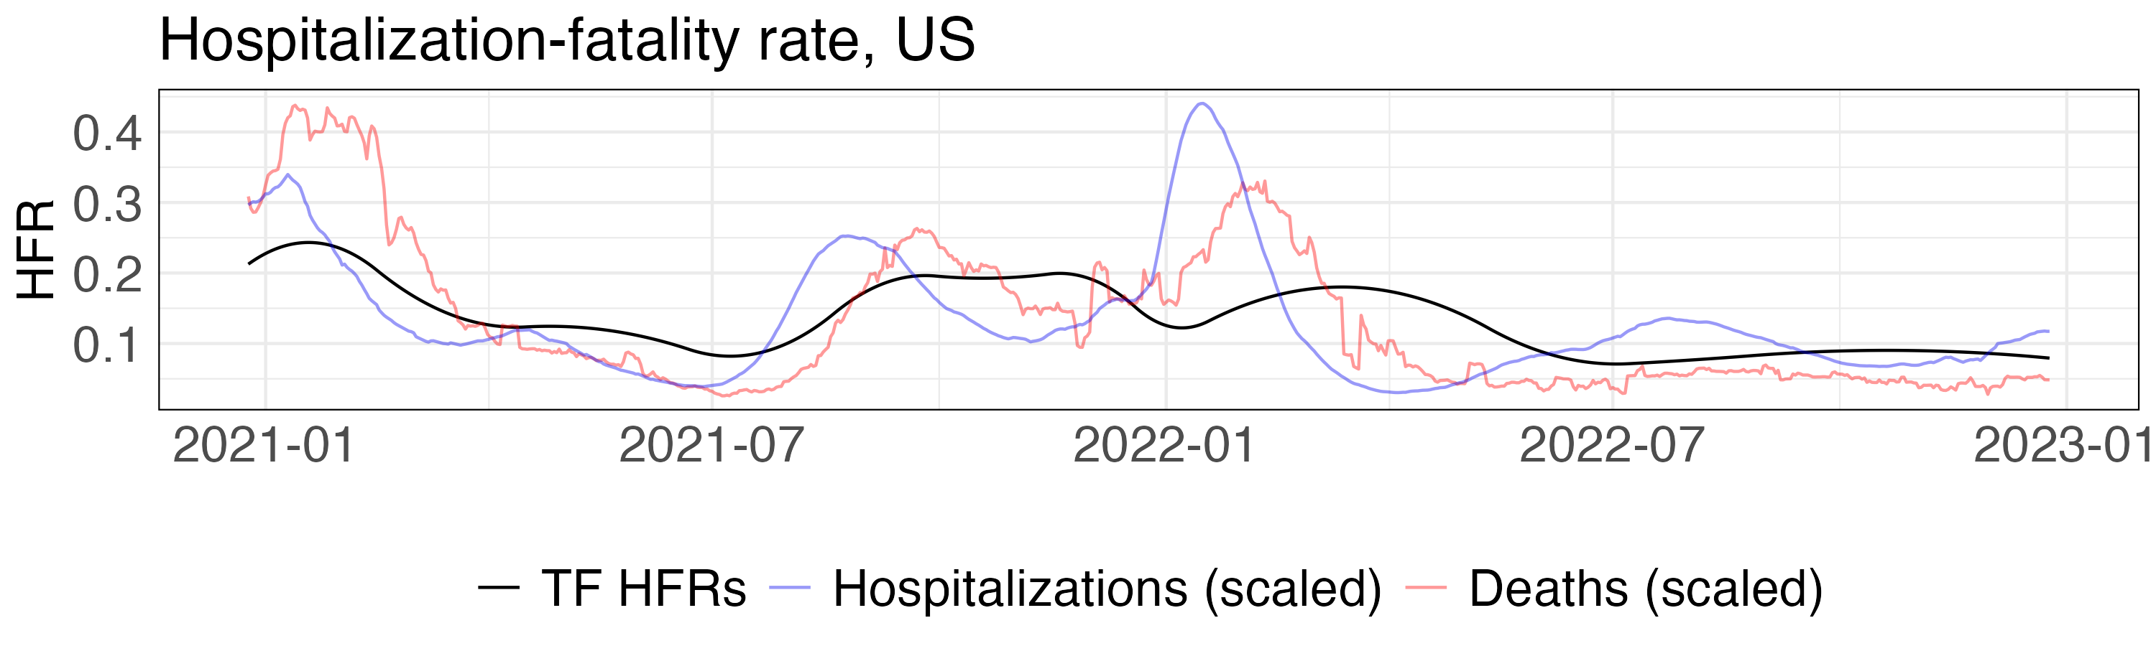
Follow-up work: Improving severity estimation
Currently, we are developing a new method that avoids these biases.
Instead of obtaining only the current severity rate, our approach estimates the curve over all time, then takes the most recent prediction.
We approximate maximum likelihood estimation on a faithful probabilistic model, using modern smoothing techniques for stability.
Preliminary results demonstrate large improvements on retrospective analysis; we have yet to test its efficacy in the real-time setting.

Slide 13




Collaborators

Slide 14

Thanks for your attention!

